Slide 1
Heart Disease Prediction System using Machine Learning
Nawal Ayesha Khan 1911301042
Humayra Khanam Sneha
1811176042

Slide 2

Nowadays, an alarming amount of deaths occur due to cardiovascular diseases. Hence, it would be helpful if this threatening disease could be detected and prevented beforehand.
According to CDC reports, heart disease is one of the most frequent causes of death for most races in the United States
Almost half of all Americans (47%) have at least 1 of the 3 key risk factors for heart disease: high blood pressure, high cholesterol, and smoking.
Other key indicators include diabetic status, obesity (high BMI), lack of physical activity, and excessive drinking of alcohol.
In our project, we will be taking various medical attributes of a patient as input features to predict whether the patient is likely to be diagnosed in the future with cardiovascular disease or not through the application of machine learning methods.

Slide 3
Literature review

Slide 4
Prediction of Heart Diseases using Random Forest (Madhumita Pal, Smita Parija)
The objective of the work is to predicts the occurrence of heart disease of a patient using random forest algorithm.
The dataset was accessed from Kaggle site. Different types of python libraries such as pandas, Sklearn, NumPy, matplotlib are used for processing the algorithms. Using EDA technique, data was analyzed in Jupyter notebook. 10-fold cross validation technique is used for spitting the data set into training and testing data.
Factors examined: Heart Attack, Heart Failure, Smoking, High Blood Pressure, High Cholesterol, Diabetes and Prediabetes, Being overweight, Physical inactivity, Metabolic syndrome, Family history, Age being above 55, History of preeclampsia, Symptoms of Heart attack, Nausea.
The dataset contains 303 samples and 14 attributes are taken for features of the dataset. Then it was processed using python open access software in Jupyter notebook.

Slide 5
The datasets are classified and processed using machine learning algorithm Random forest.
80% of the dataset has taken for training, 20% has taken for testing phase.
From the confusion matrix we get more sophisticated metrics like sensitivity, specificity and AUC that can help us to make a decision in the classification process.
Using random forest algorithm, they obtained accuracy of 86.9% for prediction of heart disease with sensitivity value 90.6% and specificity value 82.7%. From the receiver operating characteristics (ROC) curve, they obtained the diagnosis rate for prediction of heart disease of 93.3%. Therefore, the random forest algorithm has proven to be the most efficient algorithm for classification of heart disease and therefore it is used in the proposed system.

Slide 6
Bagging Technique to Reduce Misclassification in Coronary Heart Disease Prediction Based on Random Forest (A Saifudin, U.U Nabillah, and T Desyani)
Many proposed the application of a machine-learning algorithm to diagnose/predict coronary heart disease, but have not given perfect results.
Experimental results show that bagging techniques can reduce misclassified predictions of coronary heart disease. To reduce misclassification prediction of coronary heart disease, the ensemble bagging algorithm is applied because it can improve classification accuracy.
They compared the basic model applied by the Random Forest algorithm without being optimized to a model integrating Random Forest with bagging techniques. The prediction of coronary heart disease using the Random Forest algorithm with bagging techniques to have a better performance compared to the Random Forest algorithm without being optimized. The accuracy and AUC performance models have the same high values for the Random Forest algorithm with the bagging technique.

Slide 7
Heart disease prediction using data mining
This paper suggests an automated approach for diagnosing heart infections dependent on earlier information like symptoms, manifestations, and body conditions of the patient, by using Decision Tree and Naïve Bayes, for forecasting cardiovascular or heart disease.
Different parameters that indicate the risk of heart illness are smoking tendency, cholesterol percentage, any prior family history of heart diseases, lack of physical exercise, largeness, and hypertension.
The dataset that has been used is the Cleveland dataset, with 14 attributes.
Decision tree classification model was fitted and accuracy was found to be 81.97%. With Naïve Bayes classifier, accuracy was found to be 85.25%. Thus, from the prediction we can say that accuracy of Naïve Bayes is more than that of Decision Tree.

Slide 8
Heart disease prediction using machine learning algorithms
Multiple algorithms of machine learning, such as logistic regression and KNN, are used to predict and classify patients with heart disease.
According to the results, KNN, Random Forest Classifier, and Logistic regression yield a better result than that of other algorithms that have been used, such as SVC and Decision tree.
The algorithms that used are more precise and save a lot of money, i.e., it is cost-efficient and faster than the algorithms that the previous researchers used.
Moreover, the maximum Accuracy obtained by KNN and Logistic Regression is equal to 88.5%, which is greater than or almost similar to the accuracies obtained from previous research.

Slide 9
Methodology
For this project, we have chosen to use the Decision-Tree Classifier algorithm to predict the results.
Jupyter notebook has been used to analyze and visualize the data, as well as test samples after training our model.

Slide 10
Data set
We have chosen to use a data set from Kaggle.
It consists of 18 columns, majority of them being used as factors for the prediction, while Heart Disease column will used as the target feature.
319795 data instances are present in dataset.
The data set has been linked below: https://www.kaggle.com/datasets/kamilpytlak/ personal-key-indicators-of-heart-disease

Slide 11
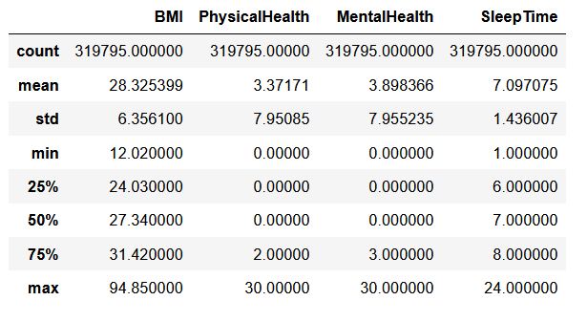
Summary of dataset

Slide 12
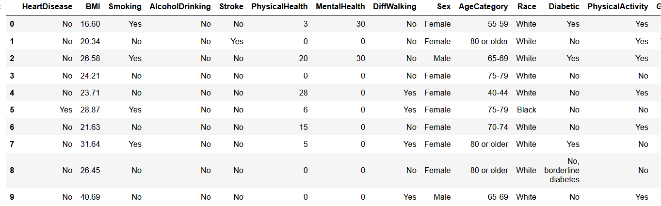
Initial dataset

Slide 13
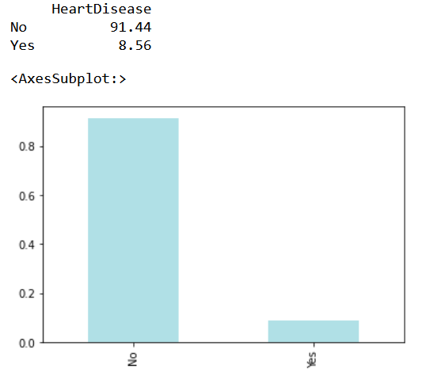
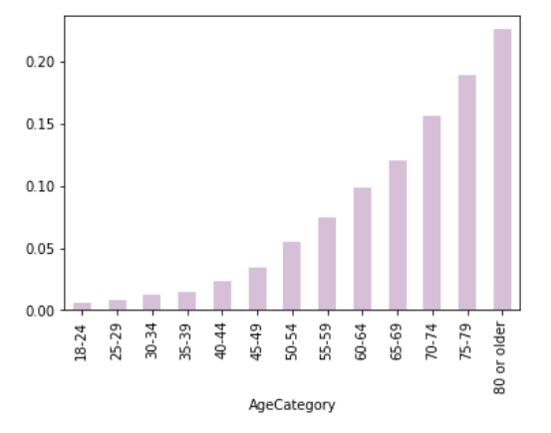
Percentage of heart disease
Age distribution

Slide 14
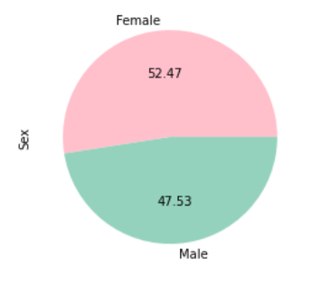
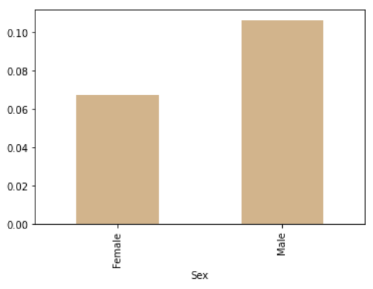
Distribution of pie chart by Gender
Proportion of each gender that tested positive for Heart Disease

Slide 15
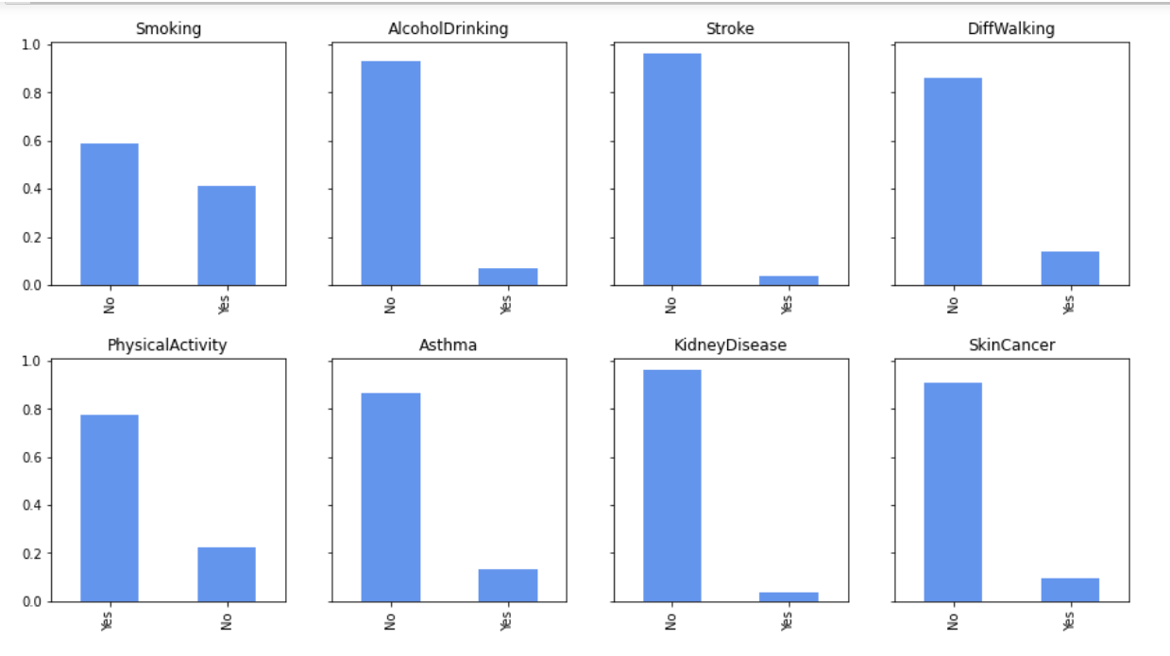
Bar charts for each categorical column

Slide 16
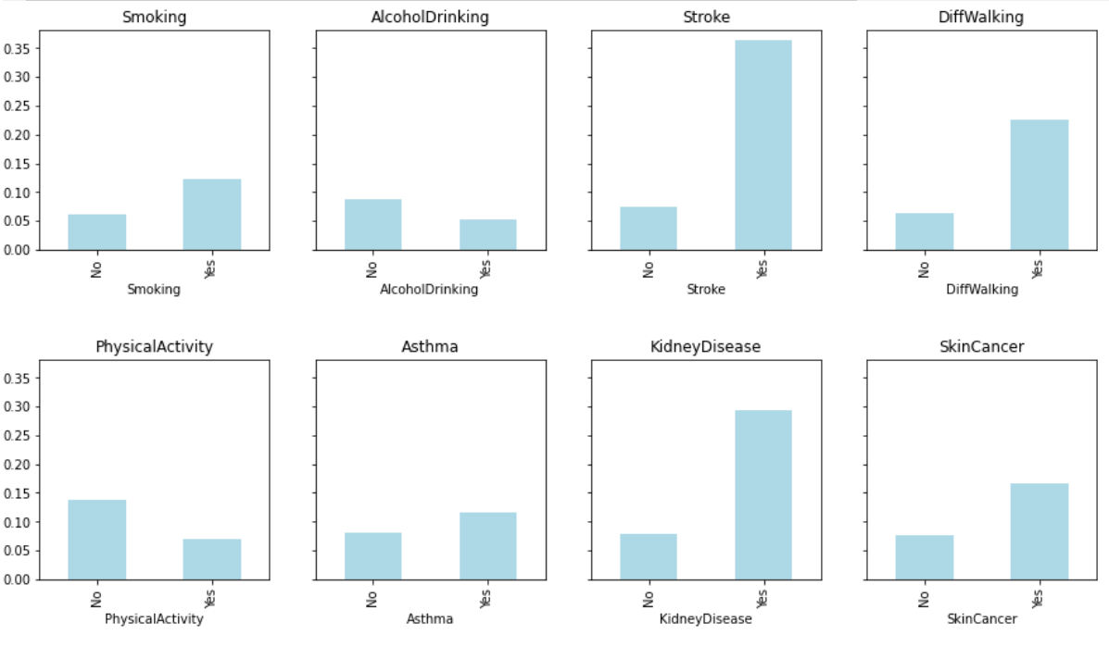
Proportion of each column testing positive for Heart disease

Slide 17
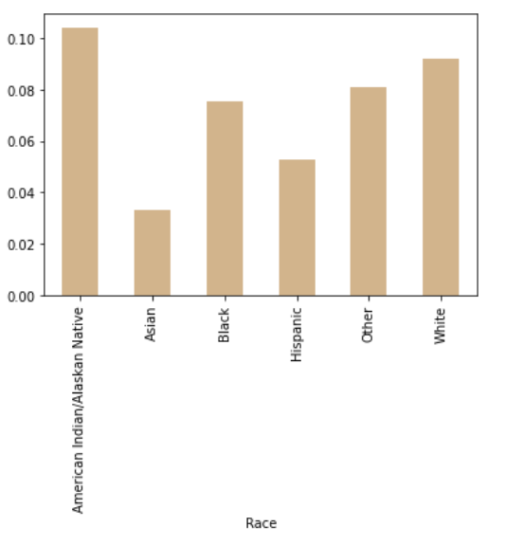
Proportion of each Race category that tested positive for Heart disease

Slide 18
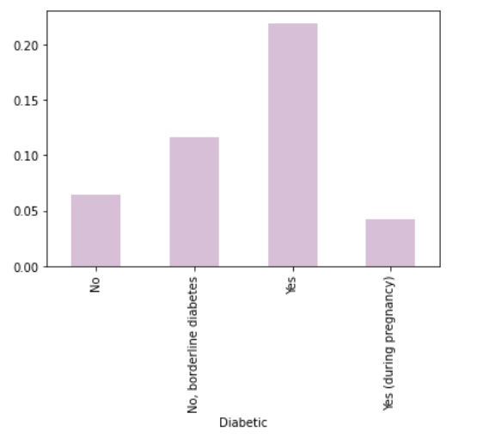
Proportion of Diabetic categories that tested positive for Heart disease

Slide 19
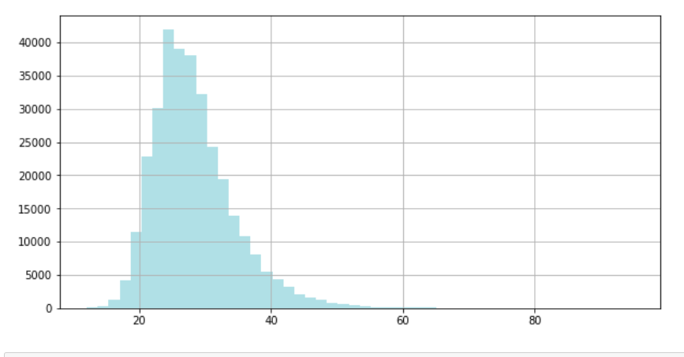
Distribution of BMI in dataset

Slide 20
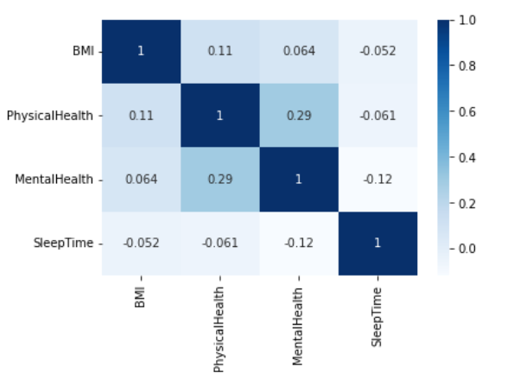
Correlation matrix

Slide 21
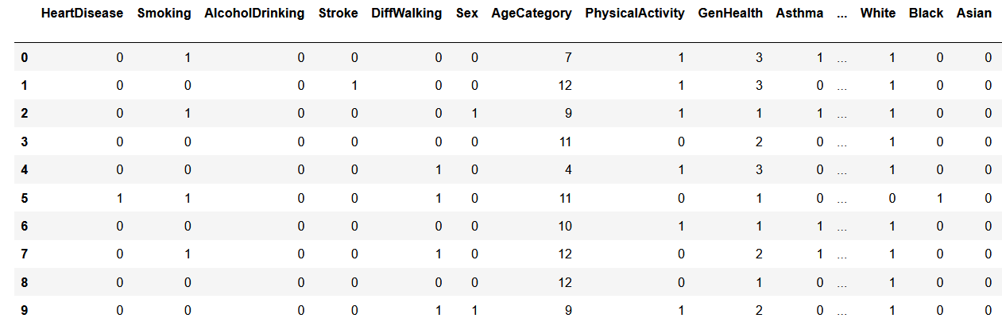
Final dataset after encoding and dropping of null values

Slide 22
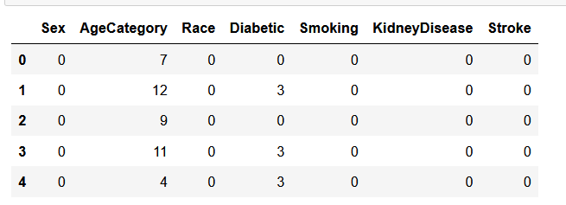
Dataframe used for model
Input features: Sex, AgeCategory, Race, Diabetic, Smoking, KidneyDisease, and Stroke
Target feature: HearDisease

Slide 23
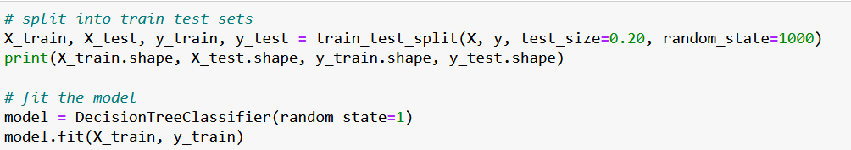
Data training and testing

Slide 24
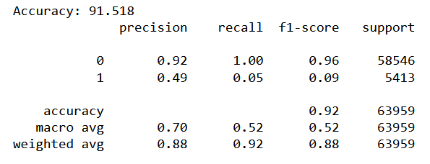
Results and Analysis
Accuracy measured: 91.52%

Slide 25
References
[1] CDC. Know Your Risk for Heart Disease. Accessed March 20, 2022. https://www.cdc.gov/heartdisease/risk factors.htm
[2] scikit-learn developers. Decision Trees. Accessed March 20, 2022. https: //scikit-learn.org/stable/modules/tree.html
[3] Kamil Pytlak. Personal Key Indicators of Heart Disease. Accessed March 18 2022.
[4] Madhumita Pal and Smita Parija 2021 J. Phys.: Conf. Ser. 1817 012009. Prediction of Heart Diseases using Random Forest
[5] A Saifudin et al 2020 J. Phys.: Conf. Ser. 1477 032009. Bagging Technique to Reduce Misclassification in Coronary Heart Disease Prediction Based on Random Forest.

Slide 26
Thank you!

